Slide 1



CODEVEDA - HACKATHON 2026
Problem Statement Title: AI-Powered Smart Urban Mobility & Traffic Control Intelligence Platform for Bengaluru
Theme: Using Azure AI and real-time data to solve urban traffic congestion.
Team Name: Tech Titans
Team Leader’s Name: Pudi Pavani
Team Members Name : Kumatha Thriveni, Kurra Pothula Bhanu Gowtham, Lagisetty Mahesh, Siripireddy Vignai
Alliance School of Advanced Computing | Microsoft Azure Developer Community 1

Slide 2

IDEA TITLE
Proposed Solution (Describe your Idea)
We propose an AI-powered smart traffic prediction and route optimization system built using Microsoft Azure services.
The system collects traffic data from GPS and historical datasets, which is processed using IoT Hub and stored in Database.
Using Azure Machine Learning, the system analyzes this data to predict traffic conditions minutes in advance. The predicted results are displayed on a web application developed for users and authorities.
In the website, users enter their start and destination locations, and the system suggests the best and least congested route using Maps. If traffic is expected, it provides alternate routes, helping users avoid delays.
Additionally, the system analyzes historical data to identify peak traffic times and high congestion areas, allowing users to plan their travel more efficiently.
ASAC
2
Alliance School of Advanced Computing | Microsoft Azure Developer Community 2
Notes:
2

Slide 3
TECHNOLOGY & METHODOLOGY
Technologies to be used :
Frontend: HTML, CSS, JS (Leaflet.js)
Backend: FastAPI (Python)
APIs: OpenStreetMap, Google Maps (optional)
AI: Azure ML (Traffic Prediction)
Tools: Uvicorn, Dotenv
METHODOLOGY :
User Input → Backend API → AI Prediction → Route Optimization → Map Output
User enters source & destination
Backend processes routes
AI predicts traffic (10-min ahead)
Multiple routes generated
Best route selected & displayed
Alliance School of Advanced Computing
3
Alliance School of Advanced Computing | Microsoft Azure Developer Community 3
Notes:
3

Slide 4
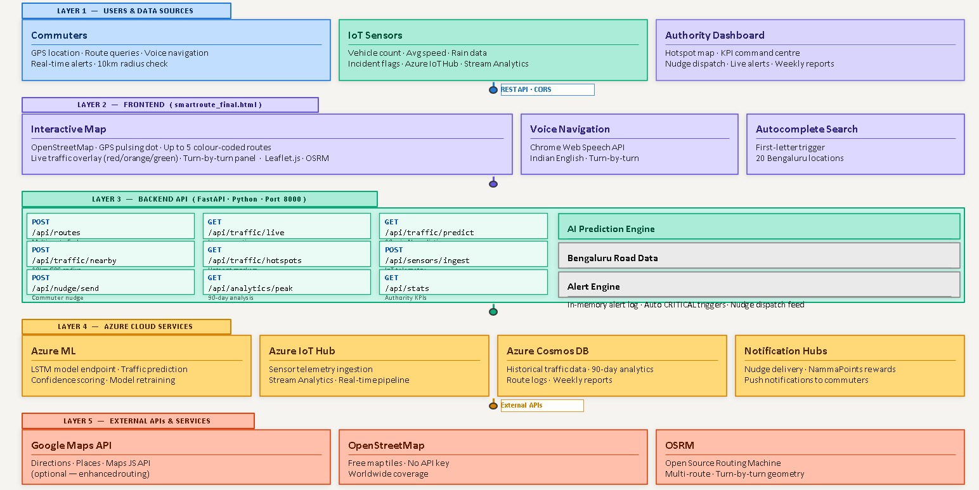
ARCHITECTURE

Slide 5
FEASIBILITY AND VIABILITY
FEASIBILITY:
Technical: Built using FastAPI, Leaflet, Azure ML
Economic: Low cost (OpenStreetMap is free)
Operational: Easy to use and implement
Scalable: Can expand to other cities
Viability:
High Demand: Growing urban traffic problems
User Value: Saves time & fuel
Smart City Use: Supports traffic management
Future Scope: IoT + mobile integration
Alliance School of Advanced Computing
4
Alliance School of Advanced Computing | Microsoft Azure Developer Community 4
Notes:
4

Slide 6
IMPACT AND BENEFITS
Impact:
Reduces traffic congestion
Supports smart city development
Improves urban mobility
Benefits:
Faster travel time
Fuel savings & cost reduction
Real-time traffic awareness
Better route planning
Alliance School of Advanced Computing
5
Alliance School of Advanced Computing | Microsoft Azure Developer Community 5
Notes:
5

Slide 7
RESEARCH AND REFERENCES
The study concludes that Artificial Intelligence has significant potential to transform urban infrastructure and improve city services. AI technologies can enhance transportation systems, optimize energy usage, and improve citizen engagement in governance. However, technological improvements must be combined with inclusive policies to ensure that all citizens benefit equally from smart city development.
https://github.com/Lagisettymahesh/smartroutr-ai
Alliance School of Advanced Computing
6
Alliance School of Advanced Computing | Microsoft Azure Developer Community 6
Notes:
6

